Slide 1
Data Mining for Business Intelligence
Chapter 13: Association Rules
Kichun Lee, Ph.D.
Department of Industrial Engineering
Hanyang University, Seoul, Korea

Slide 2
What are Association Rules?
Study of “what goes with what”
“Customers who bought X also bought Y”
What symptoms go with what diagnosis
Transaction-based or event-based
Also called “market basket analysis” and “affinity analysis”
Originated with study of customer transactions databases to determine associations among items purchased

Slide 3
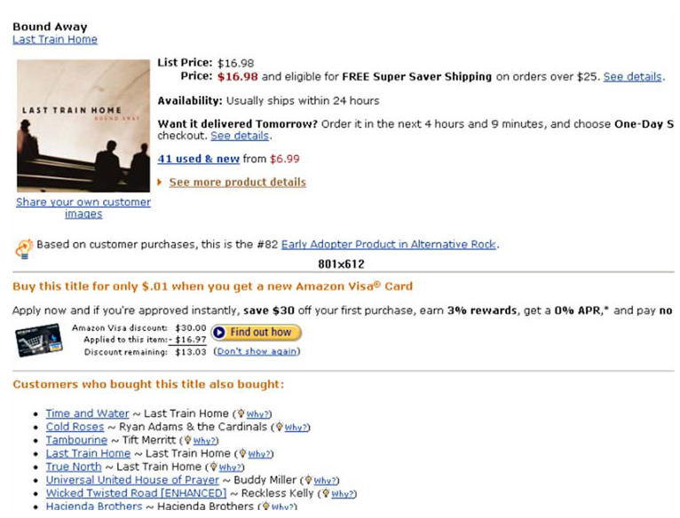
Used in many recommender systems

Slide 4
Generating Rules

Slide 5
Terms
“IF” part = antecedent
“THEN” part = consequent
“Item set” = the items (e.g., products) comprising the antecedent or consequent
Antecedent and consequent are disjoint (i.e., have no items in common)

Slide 6
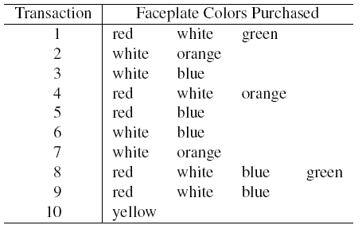

Tiny Example: Phone Faceplates

Slide 7
Many Rules are Possible
For example: Transaction 1 supports several rules, such as
“If red, then white” (“If a red faceplate is purchased, then so is a white one”)
“If white, then red”
“If red and white, then green”
+ several more

Slide 8
Frequent Item Sets
Ideally, we want to create all possible combinations of items
Problem: computation time grows exponentially as # items increases
Solution: consider only “frequent item sets”
Criterion for frequent: support

Slide 9
Support
Support = # (or percent) of transactions that include both the antecedent and the consequent
Example: support for the item set {red, white} is 4 out of 10 transactions, or 40%

Slide 10
Mining Association Rules
Two-step approach:
Frequent Itemset Generation
Generate all itemsets whose support ≥ minsup
Rule Generation
Generate high confidence rules from each frequent itemset, where each rule is a binary partitioning of a frequent itemset
Frequent itemset generation is still computationally expensive

Slide 11
Measures of Performance
Confidence: the % of antecedent transactions that also have the consequent item set
Lift = confidence/(benchmark confidence)
Benchmark confidence = transactions with consequent as % of all transactions
Lift > 1 indicates a rule that is useful in finding consequent items sets (i.e., more useful than just selecting transactions randomly)

Slide 12
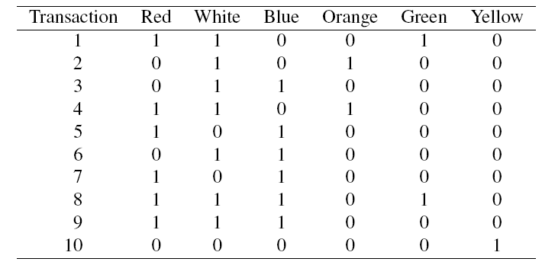
Alternate Data Format: Binary Matrix

Slide 13
Apriori Algorithm

Slide 14
Illustrating Apriori Principle
Found to be Infrequent
Pruned supersets

Slide 15
Apriori algorithm
Sequentially apply rule selection until no association rule is found
Example: find rules with the minimum support of 3/7

Slide 16
Apriori algorithm
With one item, they are no less than 3/7: assume they are all frequent.
With chosen items, construct two-items supports: {1,2}, {2,3}, {2,4}, {3,4} are selected while {1,3}, {1,4} are not.
Consider three items using the chosen items pruning them by excluding items with {1,3}, {1,4}: no frequent items are found

Slide 17
Process of Rule Selection
Generate all rules that meet specified support & confidence
Find frequent item sets (those with sufficient support – see above)
From these item sets, generate rules with sufficient confidence
-> Market basket Analysis

Slide 18
Example: Rules from {red, white, green}
{red, white} > {green} with confidence = 2/4 = 50%
[(support {red, white, green})/(support {red, white})]
{red, green} > {white} with confidence = 2/2 = 100%
[(support {red, white, green})/(support {red, green})]
Plus 4 more with confidence of 100%, 33%, 29% & 100%
If confidence criterion is 70%, report only rules 2, 3 and 6

Slide 19
Rule Generation for Apriori Algorithm
Lattice of rules
Low Confidence Rule
Pruned Rules

Slide 20
All Rules (XLMiner Output)

Slide 21
Interpretation
Lift ratio shows how effective the rule is in finding consequents (useful if finding particular consequents is important)
Confidence shows the rate at which consequents will be found (useful in learning costs of promotion)
Support measures overall impact

Slide 22
Caution: The Role of Chance
Random data can generate apparently interesting association rules
The more rules you produce, the greater this danger
Rules based on large numbers of records are less subject to this danger

Slide 23
Example: Charles Book Club
Row 1, e.g., is a transaction in which books were bought in the following categories: Youth, Do it Yourself, Geography

Slide 24
XLMiner Output
Rules arrayed in order of lift
Information can be compressed
e.g., rules 2 and 7 have same trio of books

Slide 25
Strength of market basket analysis
Clear and easily understood
Readily carried into action
Good for large data sets and do not know where to start with
The computations are relatively simple compared with neural networks and so on
User-friendly

Slide 26
Weaknesses of market basket analysis
High computation power (easily grow exponentially)
Setting the minimum level of support, confidence, and lift is required to select important rules
Determining the right set of items in the analysis can be subjective
Producing too many rules
Should be coupled with other analysis

Slide 27
Summary
Association rules (or affinity analysis, or market basket analysis) produce rules on associations between items from a database of transactions
Widely used in recommender systems
Most popular method is Apriori algorithm
To reduce computation, we consider only “frequent” item sets (=support)
Performance is measured by confidence and lift
Can produce a profusion of rules; review is required to identify useful rules and to reduce redundancy

